Slide 1
A Presentation On Design Normalized Database for Blood Bank
Presented by:
Shubham Giri
Rushi Gujarathi
Param Jadhav
Guided by:
Mr S. Y. Divekar

Slide 2
Outline
Aims/Benefit of the Micro Project:
Introduction
Literature Review
Specification ( H/W and S/W Requirements)
Proposed Methodology
Actual Methodology
ER Diagram
Action / Project Plan
Outputs of the Micro project
Applications
Conclusion
References

Slide 3
Aims/Benefit of the Micro Project
Aim:
To study the structure of Blood Bank Management system using ER-diagram and normalized tables and developing a Database for Blood Bank Management System to store the related data.
Benefits:
Helps to develop the skill of creating and using databases.
This project built an ability to use the oracle software in better way.
The benefit taken from the micro-project is that to understand and apply logic to solve different problems and find solutions for them.

Slide 4
Introduction
The proposed project “Database for Blood Bank Management System” has been developed to overcome the problems faced in the practicing of manual system.
The objective of developing such a system is to eliminate the situation of havoc and panic in cases of emergencies, so that the patient's family can stay besides each other rather than rushing for arranging blood.
Blood donation is a very delicate process and therefore, it should be managed and controlled with high caution. This means that data and information regarding blood, donors and recipients are kept in spreadsheets, papers and files arranged in alphabetical or numeric order.

Slide 5
Blood donation is a very delicate process and therefore, it should be managed and controlled with high caution. This means that data and information regarding blood, donors and recipients are kept in spreadsheets,
papers and files arranged in alphabetical or numeric order.
The process of retrieving blood, donor or recipient information is a tedious process and takes a lot of time. Considering the hospitals' and recipients' needs and the urgency usually involved, this makes it hard for the hospitals and put the recipient's life in danger.
In order to solve the above problems and improve economic benefit, we have prepared a computerized management for a grocery store.

Slide 6
Literature Review
Author / Publication | Title / Topic | Methods / Techniques used | Limitations
Shubham Tomer, Saurav Tomer, Rohit S. Remella | A Review Paper on Blood Bank Management System | Efficient working of blood bank management system. | Cannot simplify and automate the process of searching for blood in case of emergency and maintain the records of blood banks.
Mohamed Ismail Z, Tukur Anas Mohammad, Ibrahim Fawze Akar | CBBR Centralized Blood Bank Repository | Manages the blood of all blood group types. Stores secured information. Manages donors as well as receivers. Monitor the requests and proctor the attempts made at both ends. | Cannot Upload and Download the latest updates at right time. • Does not mention about the E-R diagram.
Dr. Sharad Maheshwari, Vikas Kulshreshtha | Benefits of Management Information System in Blood Bank | Easy to understand and follow to record people effectively and competently. | Contains only the database structure related to the employees.

Slide 7
Specification:
Computer System:
- Laptop[ AMD RYZEN Processor,8 GB RAM]
- Printer
Software:
- Oracle XE 10g express edition, Microsoft Word.

Slide 8
Proposed Methodology
First, we will finalize a topic by consulting with our teacher.
Beginning with we will make the draft of project proposal.
Once approved by teacher, we will use qualitative research methodology that is we will be going through some research papers and collecting more information related to blood banks. This will help us understand the processes involved, activities like campaigns and amount of data and information collected through those processes.
Proceeding further with quantitative approach, in this case, we will be arranging our documents, information and heading towards our project implementation.

Slide 9
Actual Methodology
The database for the Blood Bank Management system is mainly developed to manage a Blood Bank. So the structure of the database contains the tables related to the shop.
The employee table stores all the details of the doctores working in the store.
The table named costumer is there to store the information related to customer.
Prod table is used to store the details of products sold in the shop.
The sales1 table monitors the transactions of products brought from the wholesale dealers.
The purchase table finally checks the purchases made by the customer and will act as a receipt of the shopping.
There are some primary for building a relation within and among the tables.
The use of sequences is made here for e_id, c_id attributes of respective tables.
Some PL/SQL codes are used here to insert and update data in the tables.

Slide 10
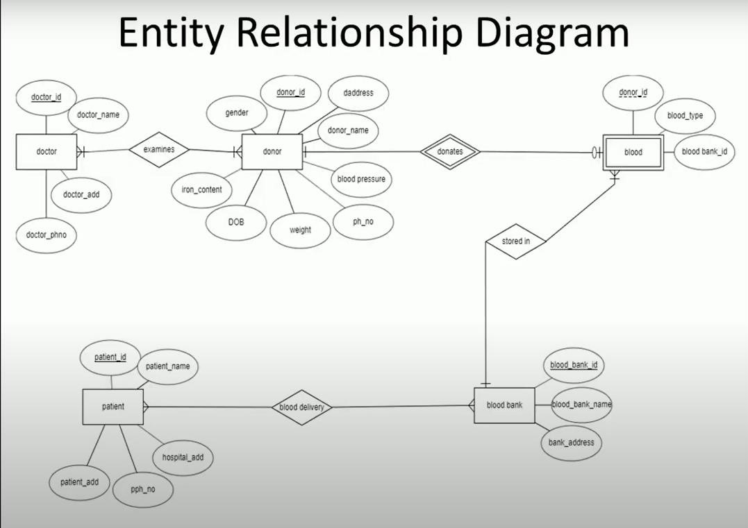
ER Diagram

Slide 11
Action / Project Plan
SELECTION OF THE TOPIC
CONSULTED WITH TEACHER
MADE A DRAFT COPY OF PROJECT PROPOSAL
DEVELOP A DATABASE AS PER THE ER DIAG.
FINAL REPORT FOR SUBMISSION
OBSERVED THE RESULTS OF THE PROJECT
APPROVED FROM TEACHER

Slide 12
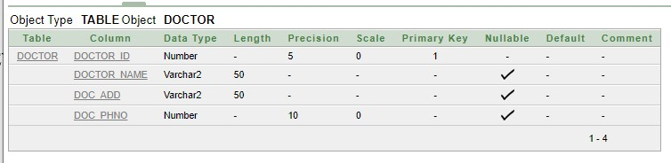
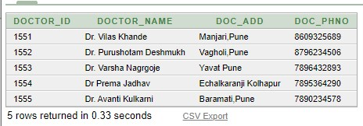
Outputs of the Micro project
TABLE:DOCTOR

Slide 13
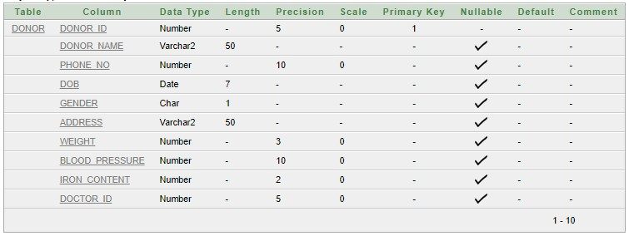
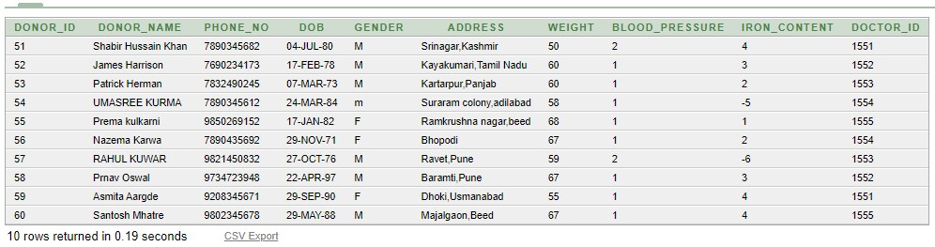
TABLE: DONOR
TABLE:
DONOR TABLE WITH VALUES:

Slide 14
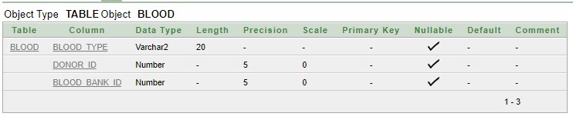
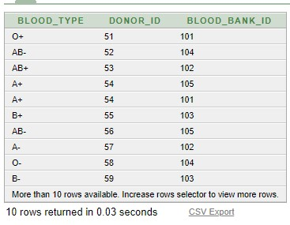
TABLE: BLOOD TABLE:VALUES OF BLOOD TABLE

Slide 15
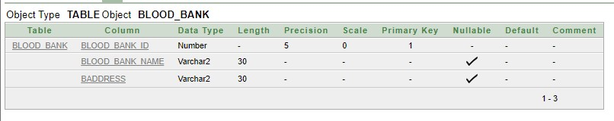
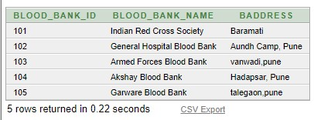
BLOOD BANK TABLE
BLOOD BANK TABLE WITH VALUES:

Slide 16
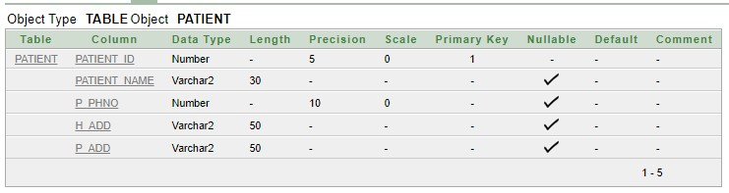
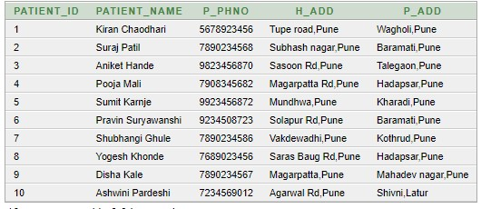
PATIENT TABLE
PATIENT TABLE WITH VALUES:

Slide 17
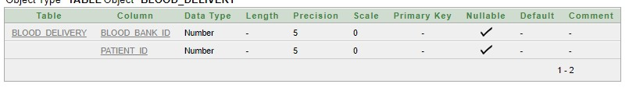
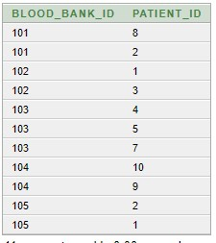
BLOOD DELIEVERY TABLE
BLOOD DELIEVERY TABLE WITH VALUES:

Slide 18
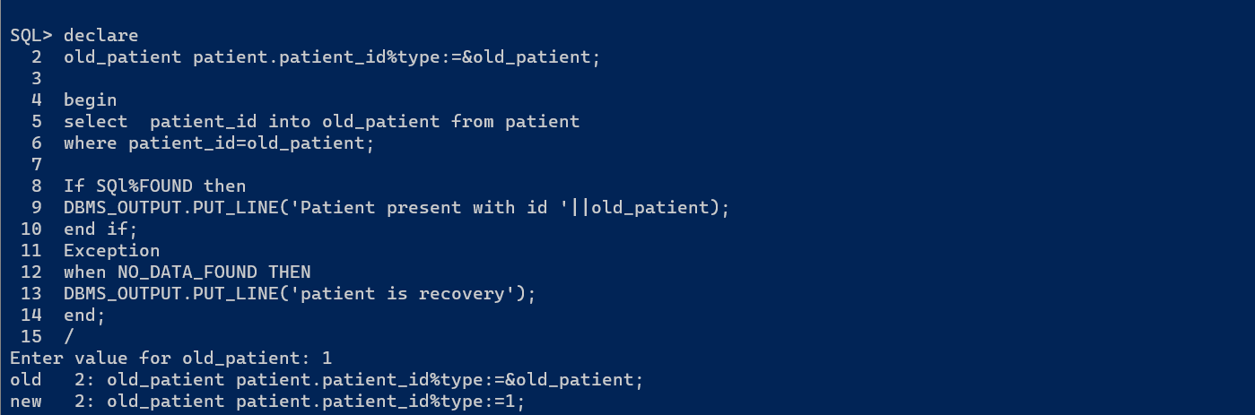
Final output

Slide 19
Conclusion
This project is built keeping in mind that it is to be used the Doctor for the patient It is built for use in small scale organization where the number of patient is limited.
According to the requested requirement the Doctor can add, manipulate, update and delete all data in his hospital.
The required records can be easily viewed by the anytime time when the user wants in an instant.
The main objective of this framework is to save time, make the system cost effective and management records efficiently.
This will also help to reduce data redundancy and auto update of the purchase table.

Slide 20
Applications
This project can be helpful make an application for blood bank management system and this database can be used as a backend for it.
This database can be used to manage small blood banks by which the management of store will be very easy and better than manually handling it.

Slide 21
Thank You…!

